Slide 1
Data Science and Analysis with R
By
Dr.Parkavi.A
Assistant Professor
CSE Department
Ramaiah Institute of Tehcnology

Slide 2
Data Science and Analysis
What is big data?
Volume
Velocity
Variety
Big data challenges
Dealing with data growth
Generating insights in a timely manner
Recruiting and retaining big data talent
Integrating disparate data sources
Validating data
Securing big data

Slide 3
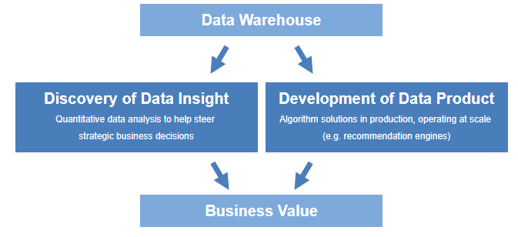
Why Data Science?

Slide 4
Examples: Data Science products
Amazon's recommendation engines
Gmail's spam filter
Computer vision used for self-driving cars

Slide 5
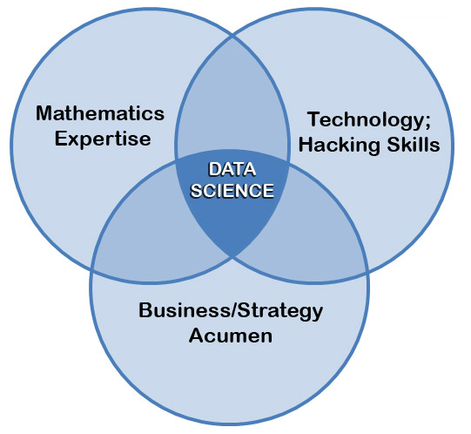
What is data science?

Slide 6
Data Science and Analysis with R
Data manipulation
Statistical modeling
Graphics
Extensibility
Add-on packages

Slide 7
The R User Interface
Rstudio
Examples:
To do arithmetic:
>1+1
----
To print series of numbers:
>100:130
----

Slide 8
The R User Interface
Example:
Helps to Finish command:
>5+
+
+1

Slide 9
R User interface
Examples
>2*3

Slide 10
Let us Learn R in detail

Slide 11
Objects
What’s an object?
Just a name that you can use to call up stored data
Example:
>Mark<-45
>Mark +1

Slide 12
Objects
Example:
die <- 1:6
die

Slide 13
To list all objects
Ls()

Slide 14
Working with objects: Vector operation
Examples
>die-1
>die/2

Slide 15
Functions
Examples:
round(3.1415)
factorial(3)
mean(1:6)
sample(x = 1:4, size = 2)
sample(x = die, size = 1)
sample(die, 1)

Slide 16
Writing Your Own Functions Example
roll <- function() {
die <- 1:6
dice <- sample(die, size = 2, replace = TRUE)
sum(dice)
}
Call a function
> roll()

Slide 17
Write a function with 2 arguments to add 2 numbers
Add<-function(a,b)
{
c=a+b
print c
}

Slide 18
Scripts
Group of R statements
Save script
Run
Source

Slide 19
Packages
ggplot2 : graphics
To install package example:
>install.packages("ggplot2")
>qplot
>library("ggplot2")
>qplot

